Slide 1
Feature importance
Which features are the most predictive or have most impact?
Terence Parr
MSDS program University of San Francisco

Slide 2
What does the model say about the data?
A good model is useful, but we usually want to interpret model
Feature importance tells us about the business or application; e.g., what matters to people renting apartments or buying used bulldozers or identifying cancer or getting a bank loan?
Importance scores themselves don’t usually mean anything, and they are often normalized 0..1 anyway
Only relative rank/magnitude matters for understanding, say, customer behavior or for feature selection to drop irrelevant features

Slide 3
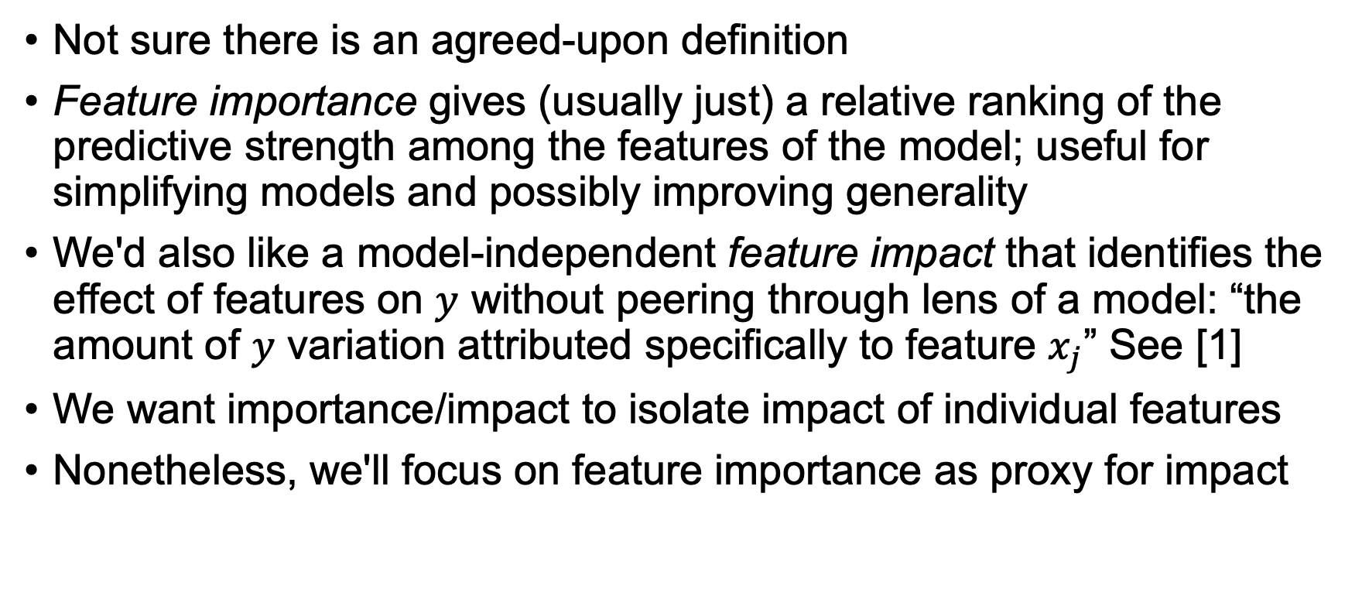
Formal definition of feature importance?
Not sure there is an agreed-upon definition
Feature importance gives (usually just) a relative ranking of the predictive strength among the features of the model; useful for simplifying models and possibly improving generality
We'd also like a model-independent feature impact that identifies the effect of features on $y$ without peering through lens of a model: “the amount of $y$ variation attributed specifically to feature $x_{j}$” See [1]
We want importance/impact to isolate impact of individual features
Nonetheless, we'll focus on feature importance as proxy for impact
Coining new term to distinguish from feature importance
[1] https://arxiv.org/abs/2006.04750 for detailed discussion

Slide 4
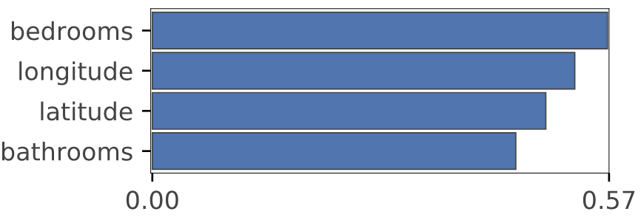
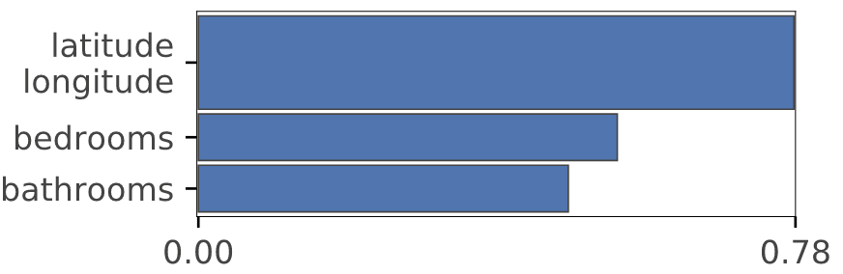
Rent example
Number of bedrooms appears to be the most important, meaning that it is the most predictive of rent price
That tells us something about the market for New York City rent
Combined, however, the location matters more by far; note: longitude and latitude are codependent features
See https://mlbook.explained.ai/first-taste.html

Slide 5
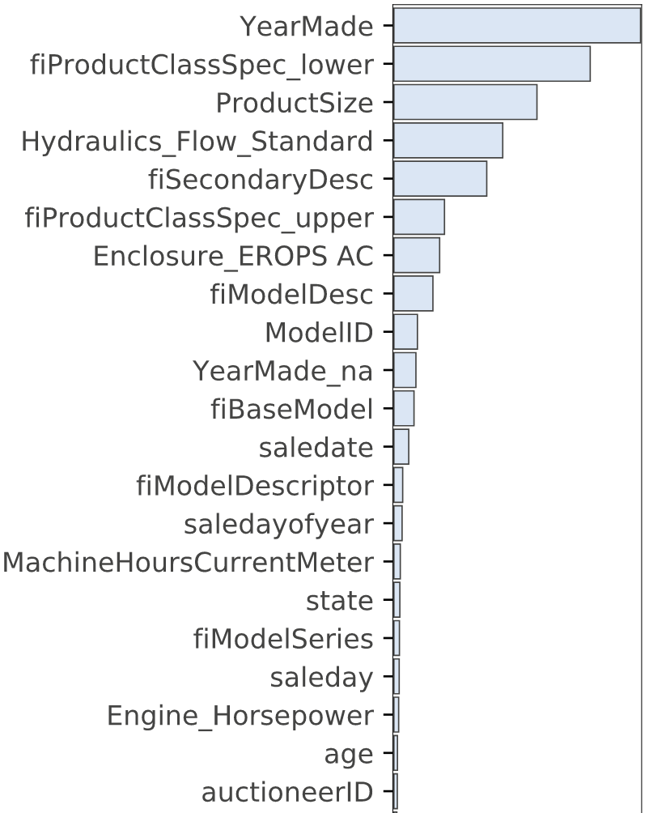
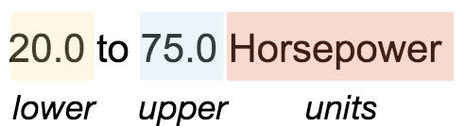
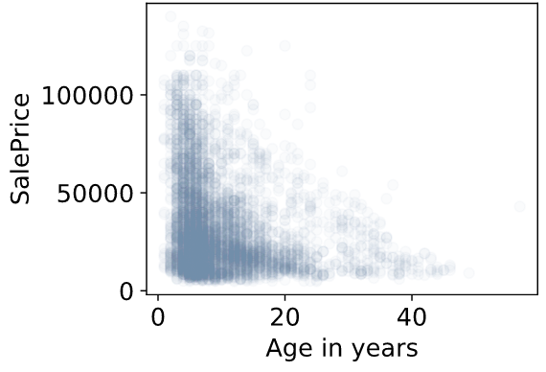
Bulldozer example
YearMade, lower capacity spec, size matter most
Note age appears unimportant but date-related features are highly correlated; other features can cover for codependent features; still looks predictive to me:
See https://mlbook.explained.ai/bulldozer-feateng.html

Slide 6
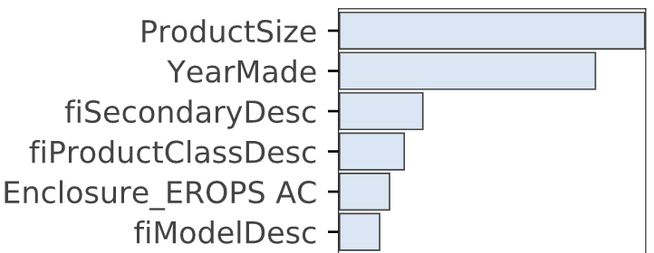

Bulldozer one-hot example
One-hot’ing categorical features temporarily and then examining feature importance can identify which category levels are important vs just the variable
E.g., one-hot Enclosure and we see that “EROPS AC” (air conditioned cab) is most important Enclosure, which is valuable marketing / business info (other levels are way down in the noise)
Could be useful for improving model but definitely useful for business intelligence

Slide 7

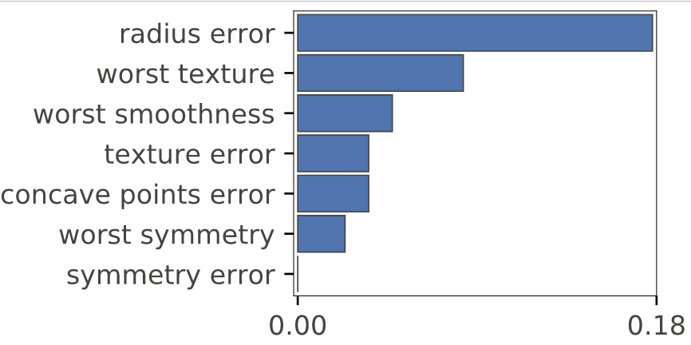
Breast cancer classification example
Distinguishing between malignant versus benign masses: radius error is strongly predictive
That is “standard error for the mean of distances from center to points on the perimeter” which could give an indication of mass edge irregularity
Worst texture is “largest mean value for standard deviation of gray-scale values”
See https://mlbook.explained.ai/first-taste.html
Image credit: https://pubmed.ncbi.nlm.nih.gov/27563488/

Slide 8
Common application: Tuning the model
Dropping unimportant features simplifies the model; fewer features make it easier to interpret/explain model behavior
Often increases accuracy and generality because the model is not taking irrelevant features into consideration (e.g., noise vars)
Simplifying models is a form of regularization
Fewer features increases training and prediction speed
Drop the lowest importance feature and retrain the model, redo validation metric; if validation metric worse, then we have dropped one too many features
Codependencies between features is why we recompute feature importances after dropping each feature; at minimum, rank of features can change dramatically after dropping a feature

Slide 9
Beware!
Can’t trust feature importances from high bias or high variance models
Importance says how important a feature is to a specific model
Sum of importances not usually meaningful; doesn’t tell you how much of the overall prediction your model has covered
When possible compute importances with validation not training set; we care about features predictive for generalization
Even with good model, importances are a clue not gospel

Slide 10
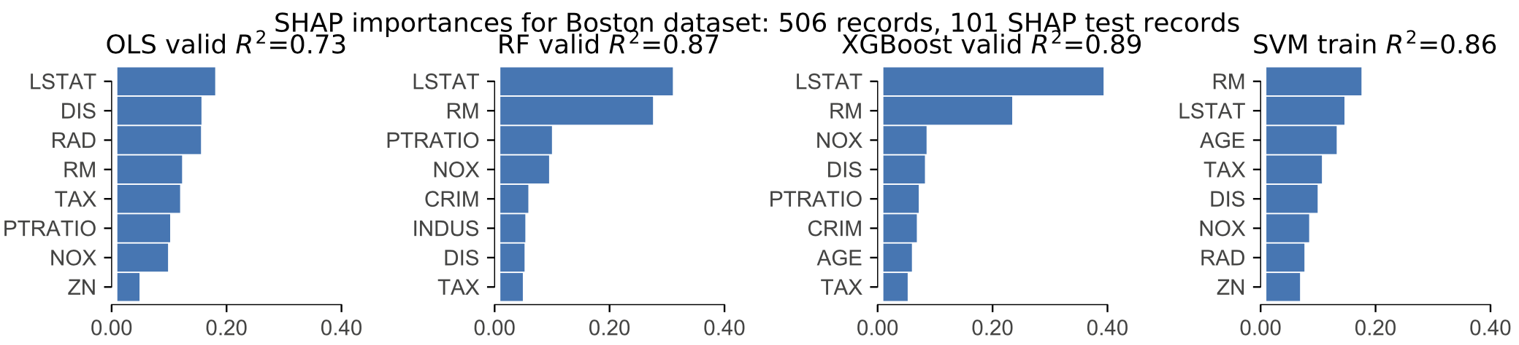
Importance is typically model-specific!
Same method applied to same data can yield different importances; here's SHAP on Boston but different models

Slide 11
Implementation of importance

Slide 12
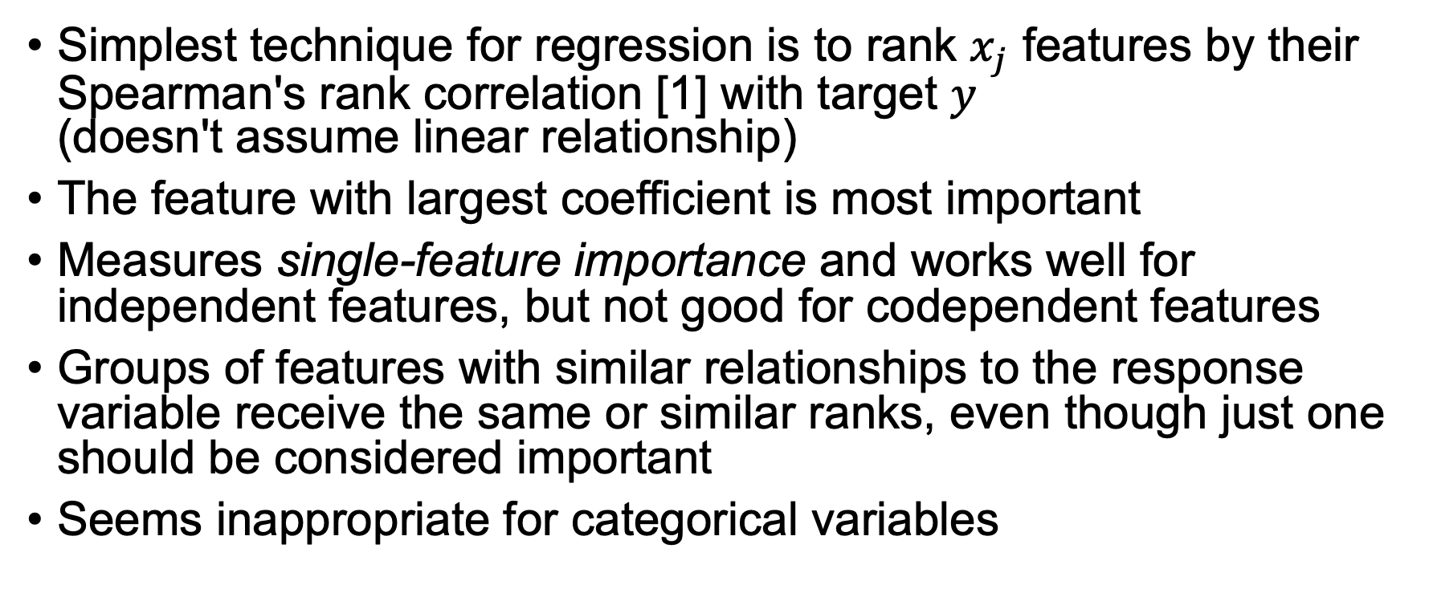
Importance directly from the data: Spearman's rank correlation
Simplest technique for regression is to rank $x_{j}$ features by their Spearman's rank correlation [1] with target $y$ (doesn't assume linear relationship)
The feature with largest coefficient is most important
Measures single-feature importance and works well for independent features, but not good for codependent features
Groups of features with similar relationships to the response variable receive the same or similar ranks, even though just one should be considered important
Seems inappropriate for categorical variables
[1] https://en.wikipedia.org/wiki/Spearman%27s_rank_correlation_coefficient

Slide 13
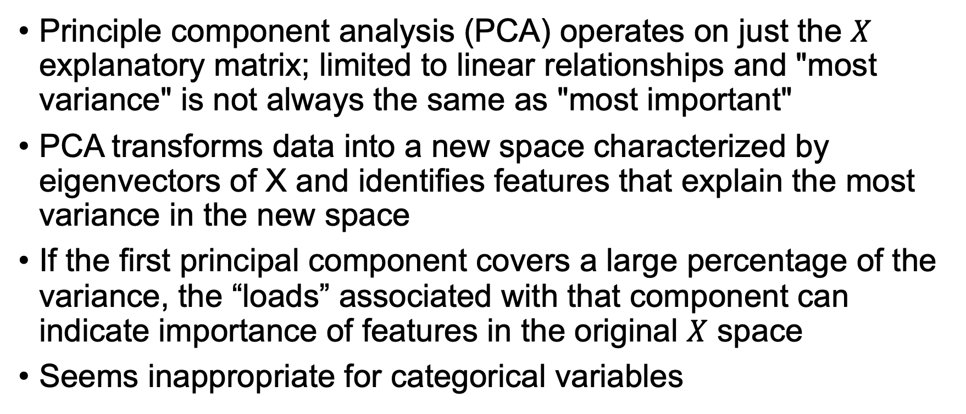
Importance directly from the data: PCA
Principle component analysis (PCA) operates on just the $X$ explanatory matrix; limited to linear relationships and "most variance" is not always the same as "most important"
PCA transforms data into a new space characterized by eigenvectors of X and identifies features that explain the most variance in the new space
If the first principal component covers a large percentage of the variance, the “loads” associated with that component can indicate importance of features in the original $X$ space
Seems inappropriate for categorical variables
Copied from https://arxiv.org/abs/2006.04750

Slide 14
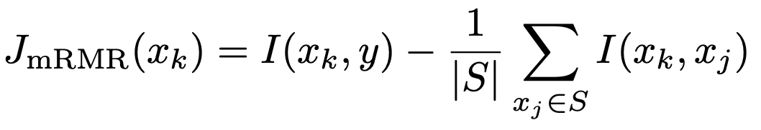
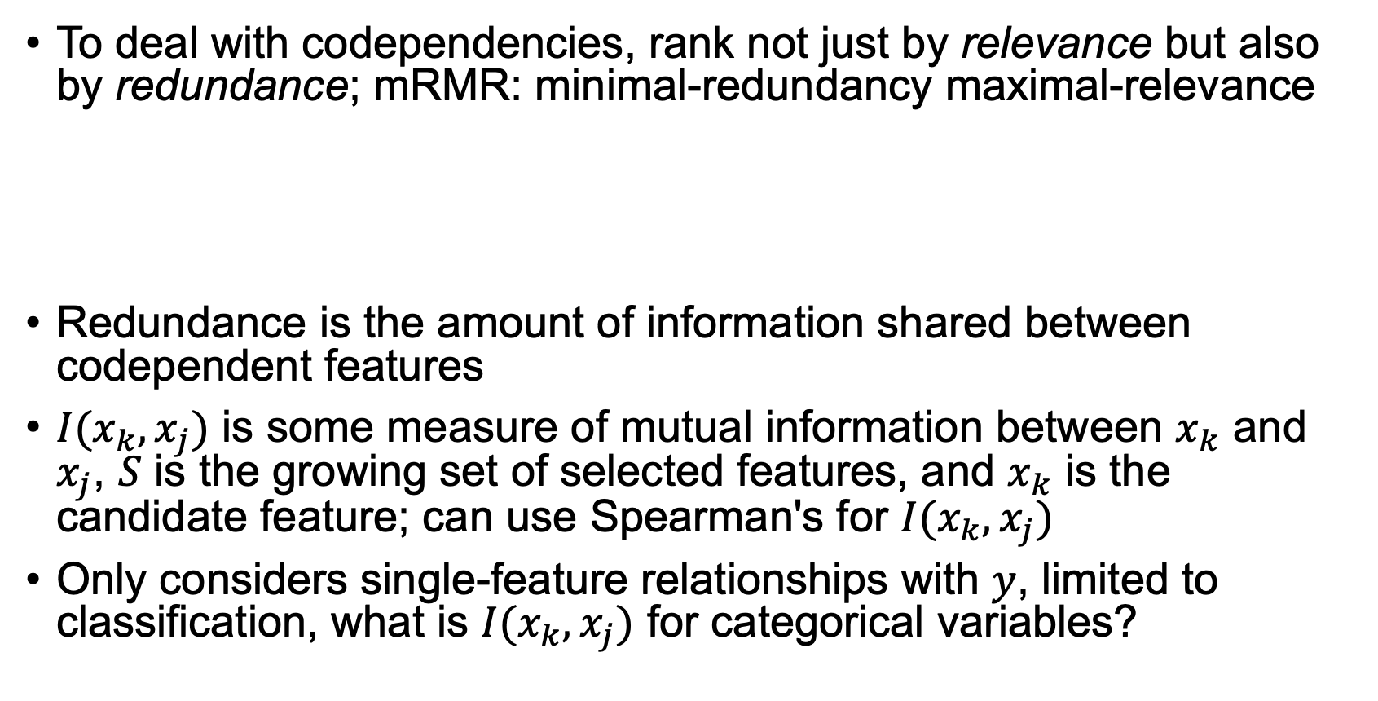
Importance directly from the data: mRMR
To deal with codependencies, rank not just by relevance but also by redundance; mRMR: minimal-redundancy maximal-relevance
Redundance is the amount of information shared between codependent features
$I(x_{k},x_{j})$ is some measure of mutual information between $x_{k}$ and $x_{j}$, $S$ is the growing set of selected features, and $x_{k}$ is the candidate feature; can use Spearman's for $I(x_{k},x_{j})$
Only considers single-feature relationships with $y$, limited to classification, what is $I(x_{k},x_{j})$ for categorical variables?

Slide 15
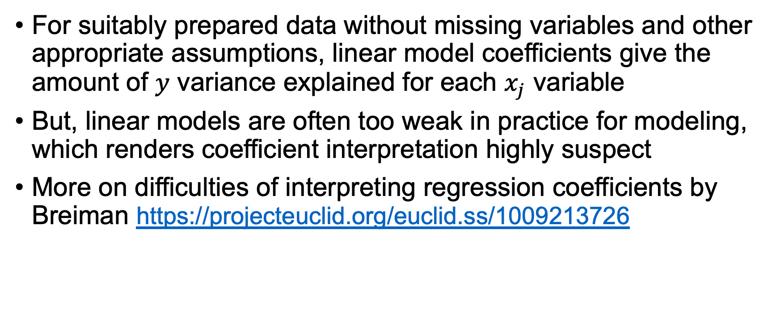
Importance via linear models
For suitably prepared data without missing variables and other appropriate assumptions, linear model coefficients give the amount of $y$ variance explained for each $x_{j}$ variable
But, linear models are often too weak in practice for modeling, which renders coefficient interpretation highly suspect
More on difficulties of interpreting regression coefficients by Breiman https://projecteuclid.org/euclid.ss/1009213726

Slide 16
So how do we really get feature importance?
RF specific and scikit-learn default: gini/MSE drop (I'd avoid)
Drop-column importance
Permutation importance from sklearn.inspection import permutation_importance
scikit-learn added after we exposed the weakness of gini drop https://explained.ai/rf-importance/index.html and see rfpimp [1]
SHAP (https://github.com/slundberg/shap) likely most accurate so far (w/amazing library) but I find it unbearably slow
[1] https://github.com/parrt/random-forest-importances/blob/master/README.md

Slide 17
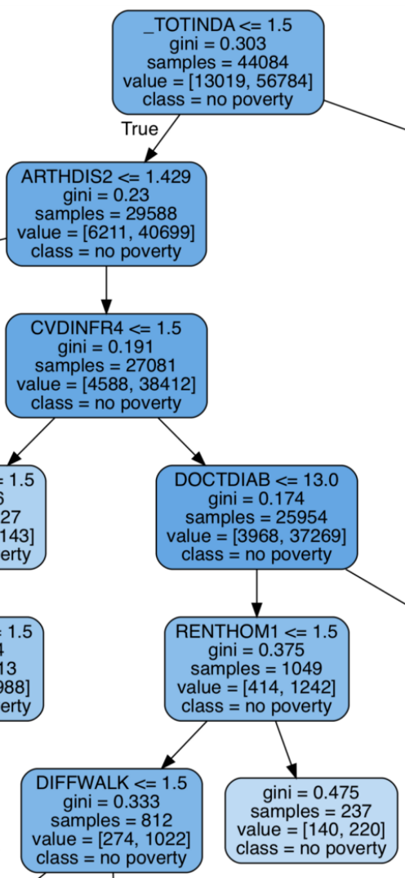
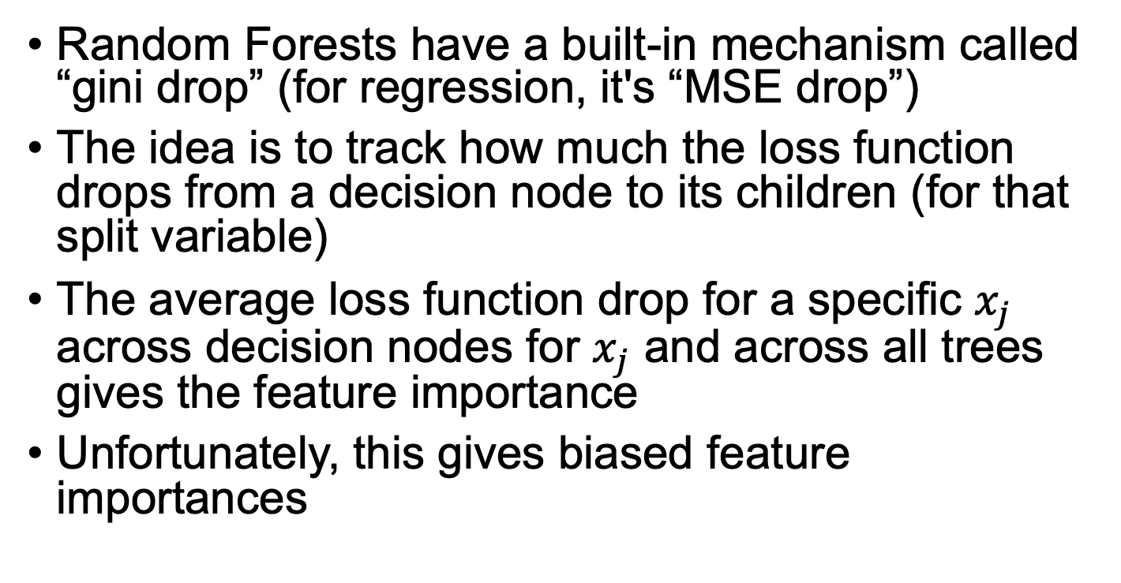
Random Forest loss function drop
Random Forests have a built-in mechanism called “gini drop” (for regression, it's “MSE drop”)
The idea is to track how much the loss function drops from a decision node to its children (for that split variable)
The average loss function drop for a specific $x_{j}$ across decision nodes for $x_{j}$ and across all trees gives the feature importance
Unfortunately, this gives biased feature importances

Slide 18
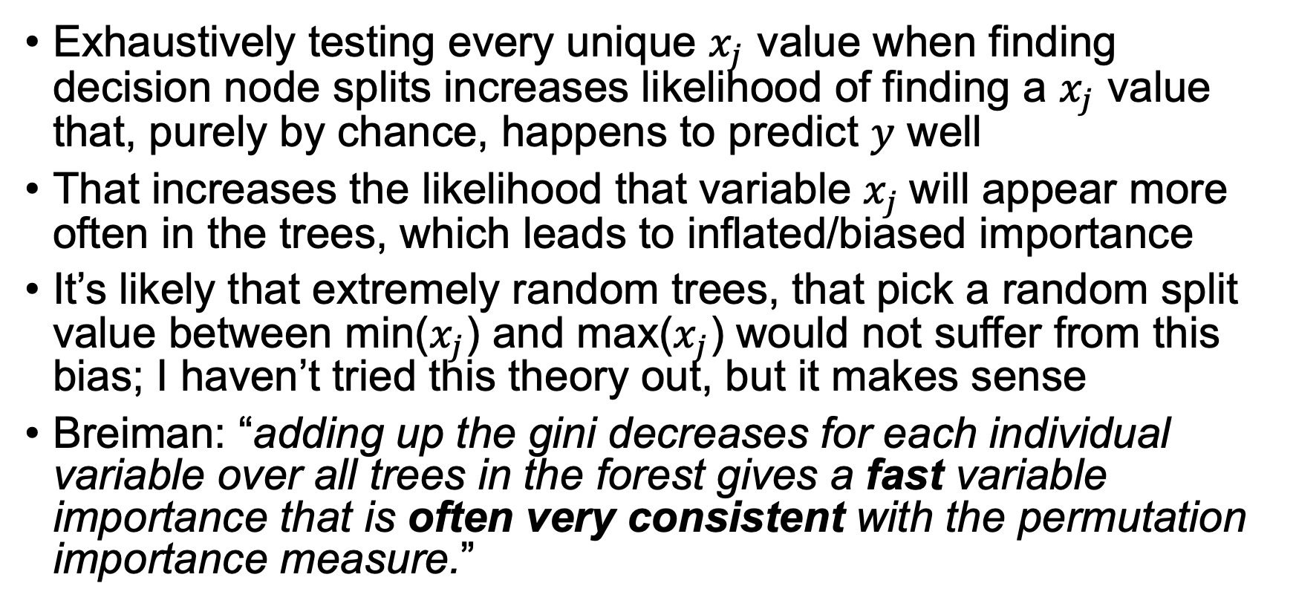
Random Forest gini/MSE drop issues
Exhaustively testing every unique $x_{j}$ value when finding decision node splits increases likelihood of finding a $x_{j}$ value that, purely by chance, happens to predict $y$ well
That increases the likelihood that variable $x_{j}$will appear more often in the trees, which leads to inflated/biased importance
It’s likely that extremely random trees, that pick a random split value between min($x_{j}$) and max($x_{j}$) would not suffer from this bias; I haven’t tried this theory out, but it makes sense
Breiman: “adding up the gini decreases for each individual variable over all trees in the forest gives a fast variable importance that is often very consistent with the permutation importance measure.”
Read more https://explained.ai/rf-importance/index.html

Slide 19
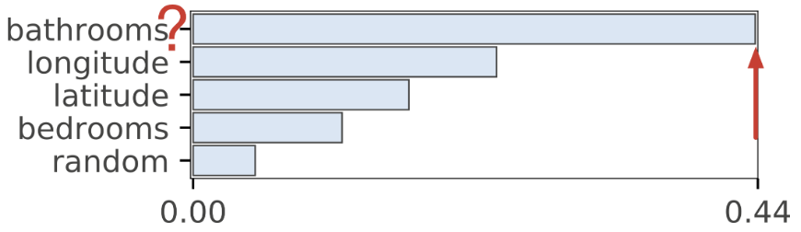
Trouble in paradise (regression)
Don’t trust default (“gini drop”) importances for RF in sklearn
Here we see the unlikely idea that New Yorkers care most about bathrooms and much more than location or bedrooms
New Yorkers can be weird, but they can’t be this fixated on bathrooms
Random noise column is last (which it should be)
Read more https://explained.ai/rf-importance/index.html

Slide 20
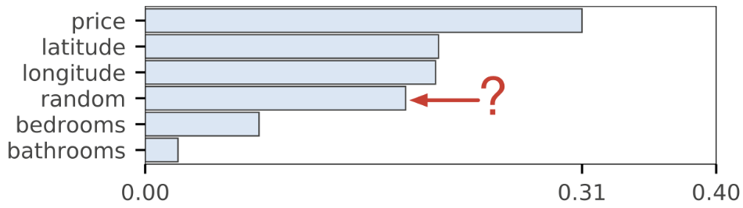
Trouble in paradise (classification: predicting interest in apt web page)
Same data but classifying interest in apartments but price is now feature not target
Random noise column is now somehow more important than bedrooms and bathrooms?
Somethin ain’t right
For more on “gini drop”, see: https://stackoverflow.com/questions/15810339/how-are-feature-importances-in-randomforestclassifier-determined
Hmm… what can we do instead?

Slide 21
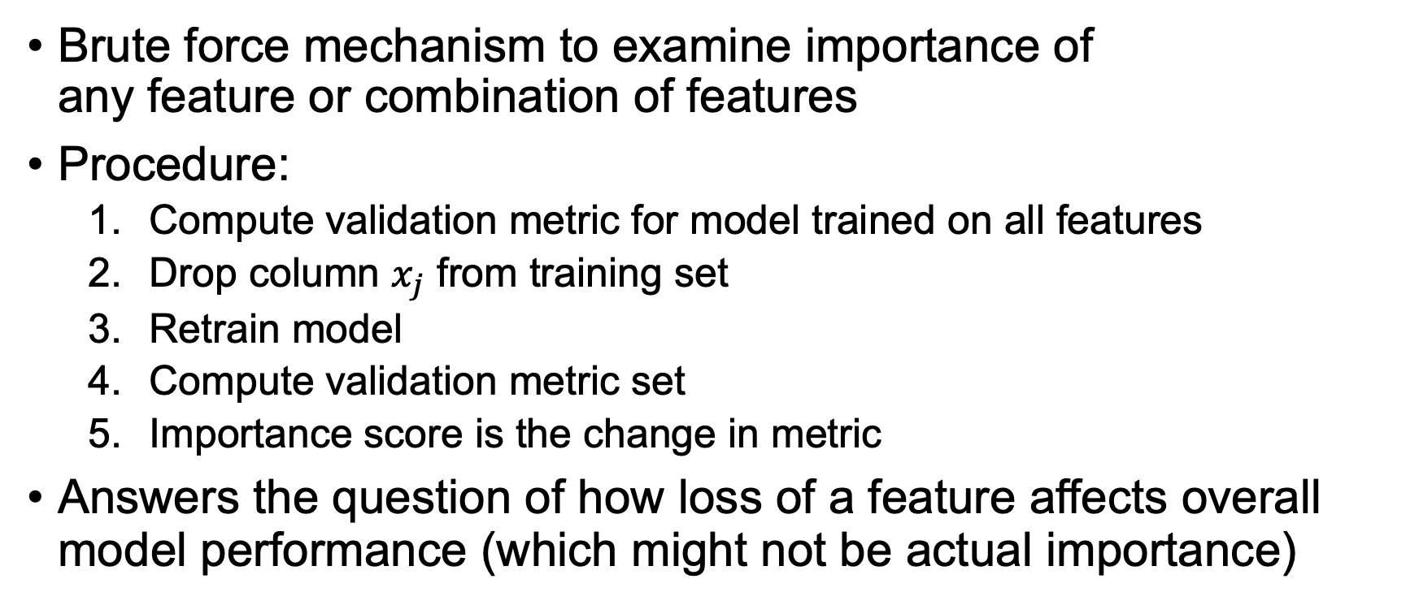
Drop-column importance
Brute force mechanism to examine importance of any feature or combination of features
Procedure:
Compute validation metric for model trained on all features
Drop column $x_{j}$ from training set
Retrain model
Compute validation metric set
Importance score is the change in metric
Answers the question of how loss of a feature affects overall model performance (which might not be actual importance)

Slide 22
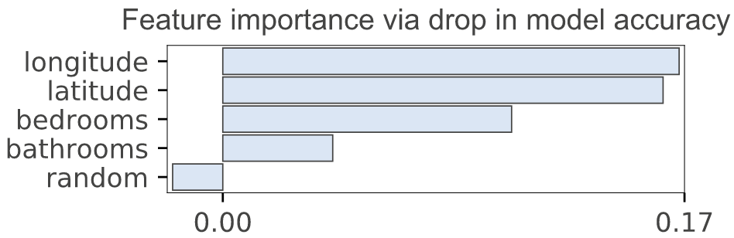
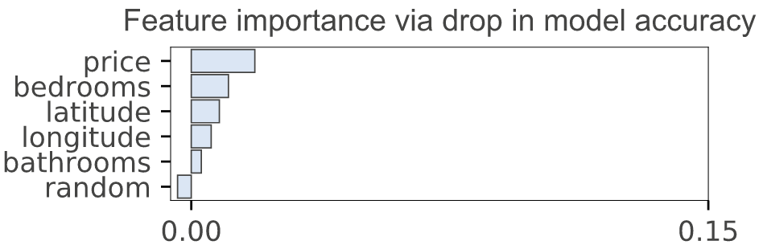
Compare drop-column to gini/MSE drop
Regressor
Classifier
default sklearn ”gini drop”
default sklearn ”gini drop”
What does negative importance mean? Means dropping improves metric!

Slide 23
Drop-column implementation
def dropcol_importances(model, X_train, y_train, X_valid, y_valid):
model.fit(X_train, y_train)
baseline = metric(y_valid, model.predict(X_valid))
imp = []
for col in X_train.columns:
X_train_ = X_train.drop(col, axis=1)
X_valid_ = X_valid.drop(col, axis=1)
model_ = clone(model)
model_.fit(X_train_, y_train)
m = metric(y_valid, model_.predict(X_valid_))
imp.append(baseline - m)
return imp

Slide 24
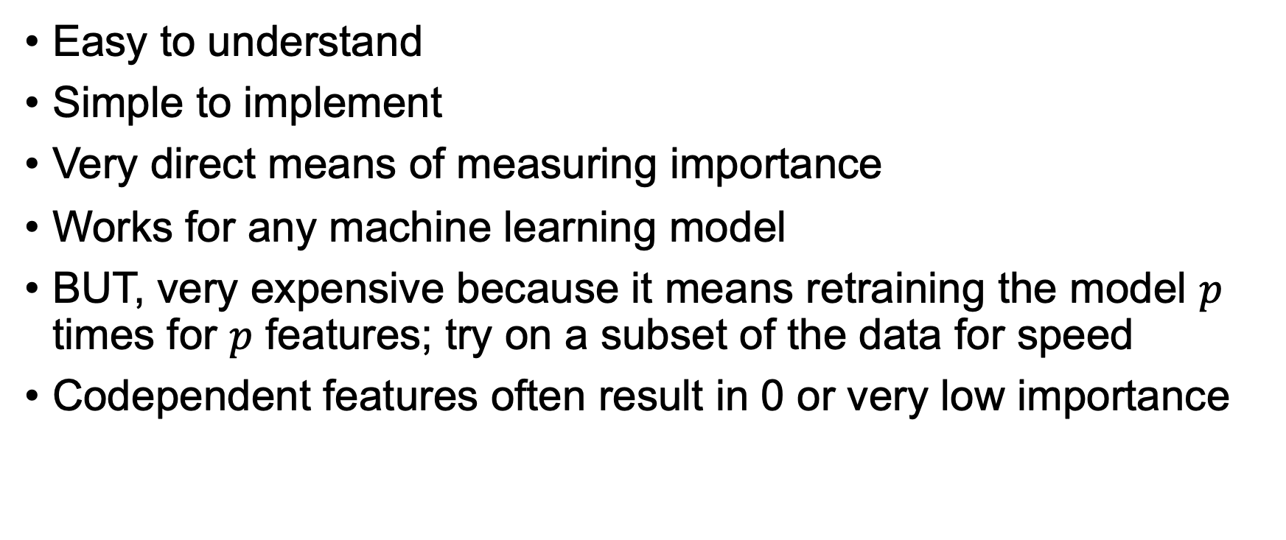
Drop-column pros/cons
Easy to understand
Simple to implement
Very direct means of measuring importance
Works for any machine learning model
BUT, very expensive because it means retraining the model $p$ times for $p$ features; try on a subset of the data for speed
Codependent features often result in 0 or very low importance

Slide 25
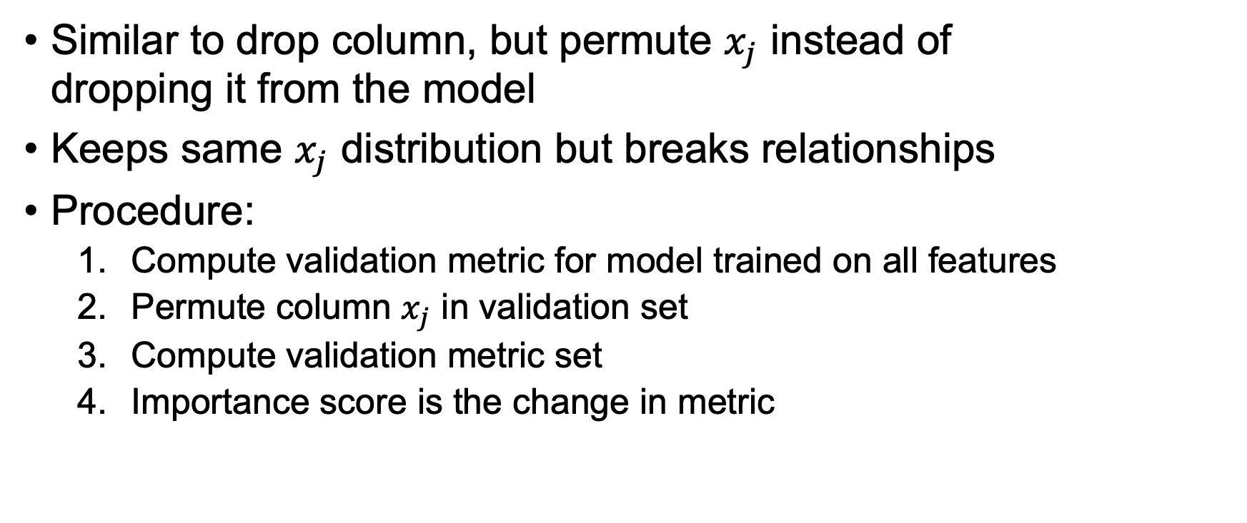
Permutation importance
Similar to drop column, but permute $x_{j}$ instead of dropping it from the model
Keeps same $x_{j}$ distribution but breaks relationships
Procedure:
Compute validation metric for model trained on all features
Permute column $x_{j}$ in validation set
Compute validation metric set
Importance score is the change in metric

Slide 26
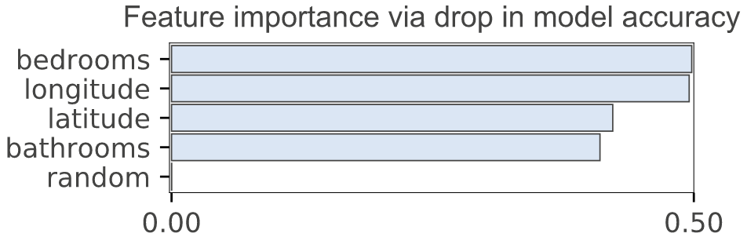
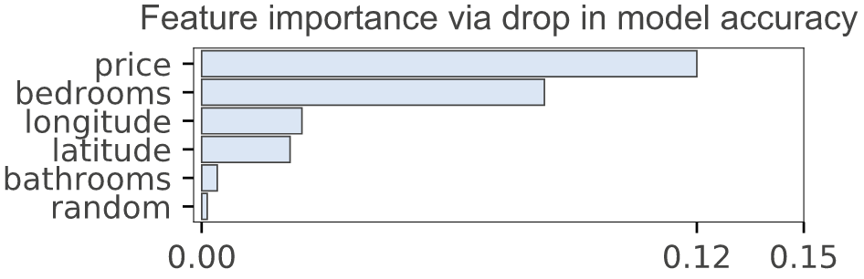
Compare permutation to gini/MSE drop
Regressor
Classifier
default sklearn ”gini drop”
default sklearn ”gini drop”
Importance via permutation
Importance via permutation

Slide 27
Permutation implementation
def permutation_importances(model, X_valid, y_valid):
baseline = metric(y_valid, model.predict(X_valid))
imp = []
for col in X_valid.columns:
save = X_valid[col].copy()
X_valid[col] = np.random.permutation(X_valid[col])
m = metric(y_valid, model.predict(X_valid))
X_valid[col] = save
imp.append(baseline - m)
return imp

Slide 28
Permutation importance pros/cons
Easy to understand
Simple to implement
Works for any machine learning model
No need to retrain the model so much more efficient than drop column importance
Can create nonsensical records through permutation, such as pregnant male, which makes the results suspect
Codependent features often share importance, such as longitude and latitude
Strobl et al “permutation importance over-estimates the importance of correlated predictor variables” https://bmcbioinformatics.biomedcentral.com/articles/10.1186/1471-2105-9-307

Slide 29
Compare drop column to permutation
Regressor
Classifier
drop-column
drop-column
permutation
permutation
(fairly different due to codependence; permutation tends to share importance scores for codependent features)
(very similar)

Slide 30
Interpreting importance results

Slide 31
Codependent features
Drop column and permutation importance consider each feature individually, though my rfpimp package lets you consider multiple features together
If all features are totally independent, then computing feature importance individually is no problem
If, however, two or more features are codependent (correlated in some way but not necessarily with a strictly linear relationship) computing feature importance individually can give unexpected results
Drop-column tends to show low importance scores and permutation tends to share importance scores for codependent features

Slide 32
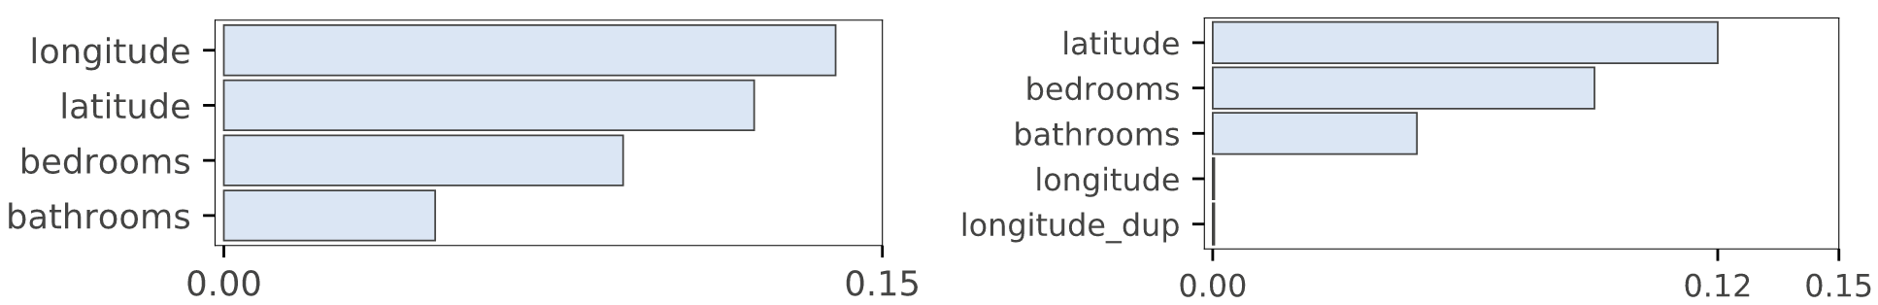
Effect of duplicated columns on drop column importance
Compare feature importances for original regressor model and another with duplicated longitude
Shocking to see BOTH longitude and duplicated longitude both go to zero importance but we measure as drop in accuracy
Dropping one doesn’t affect accuracy; other column covers for it

Slide 33
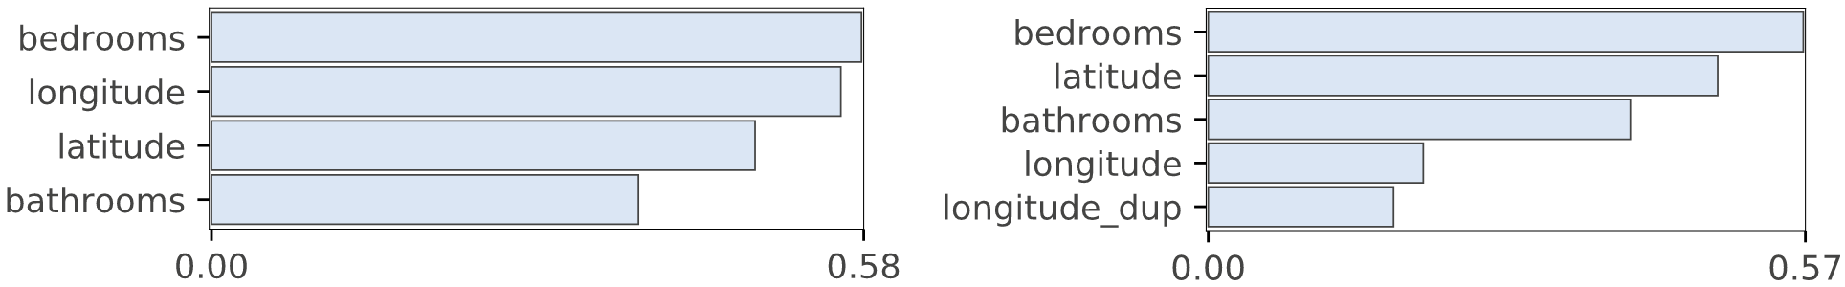
Effect of duplicated columns on permutation importance
Consider RFs; during training, node splitting should choose equally important variables roughly 50-50
Permuting a duplicated column should still allow prediction to be half supported by the other identical column
That’s what we see in practice for duplicated columns; has the effect of pulling down the perceived importance of the original

Slide 34
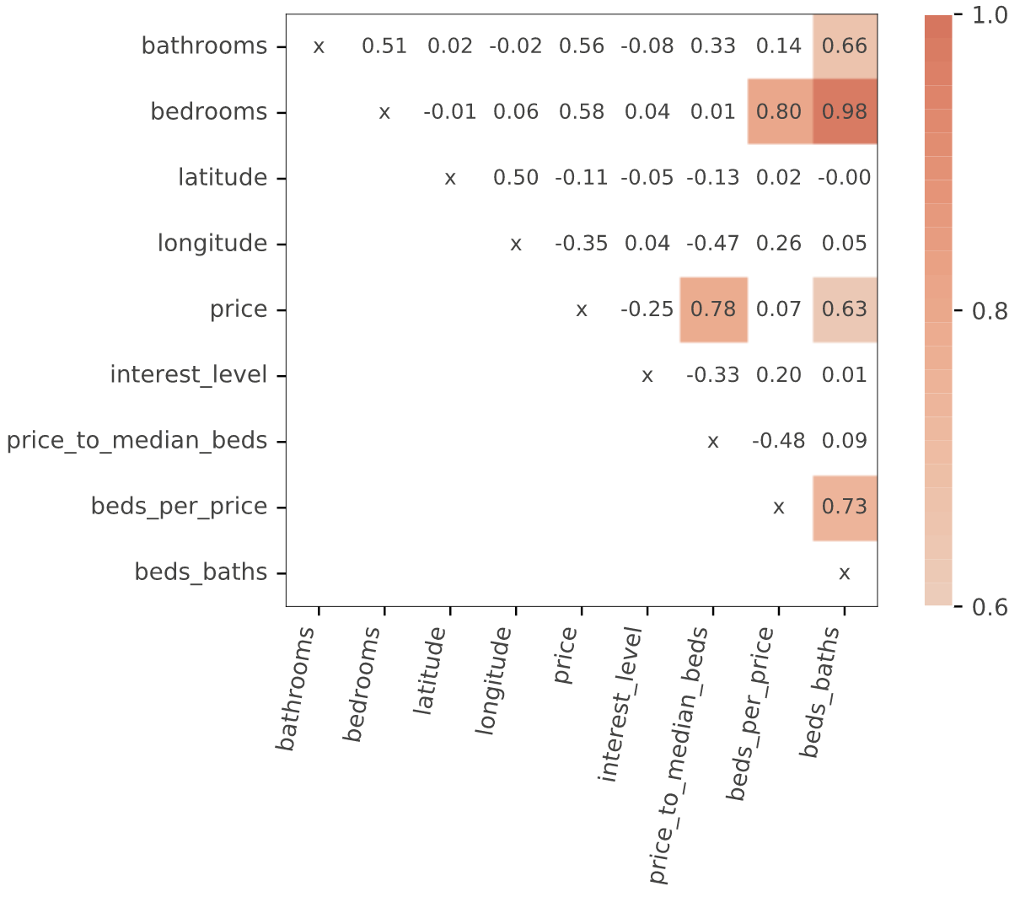
Spearman’s feature heat map
Spearman's correlation is same as converting two variables to rank values and running standard correlation
Highly-correlated features should be dropped/permuted together in feature importance metrics to decrease confusion; E.g., as bedrooms, beds_baths, and beds_per_price

Slide 35
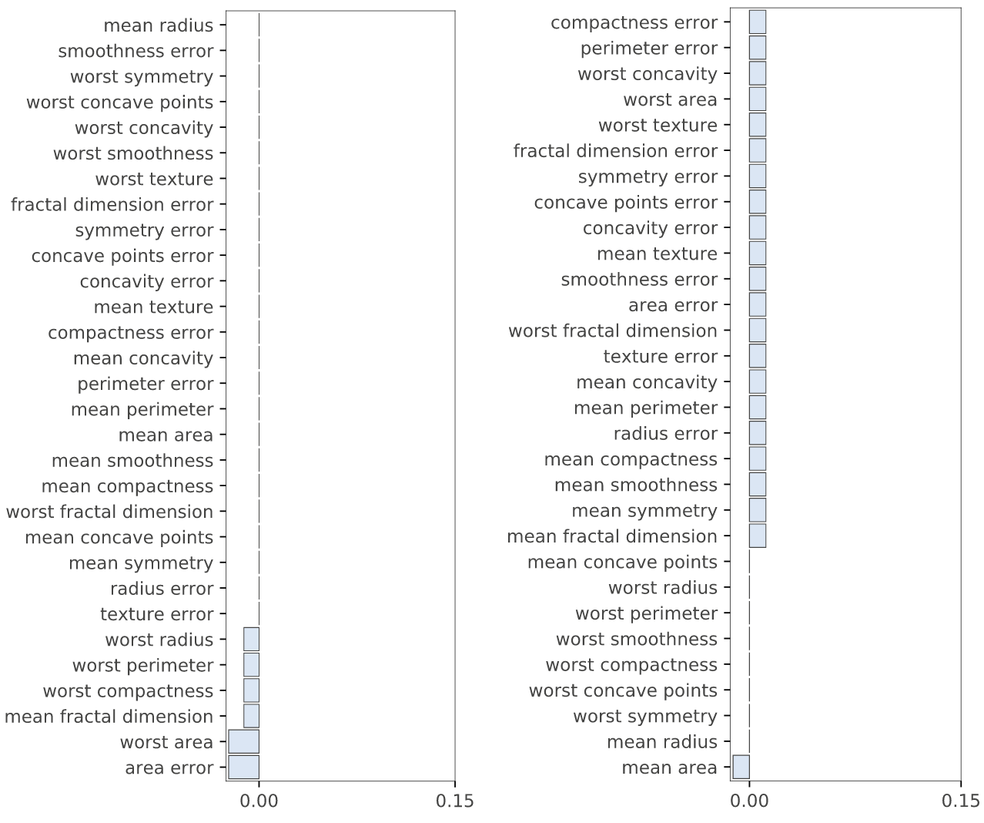
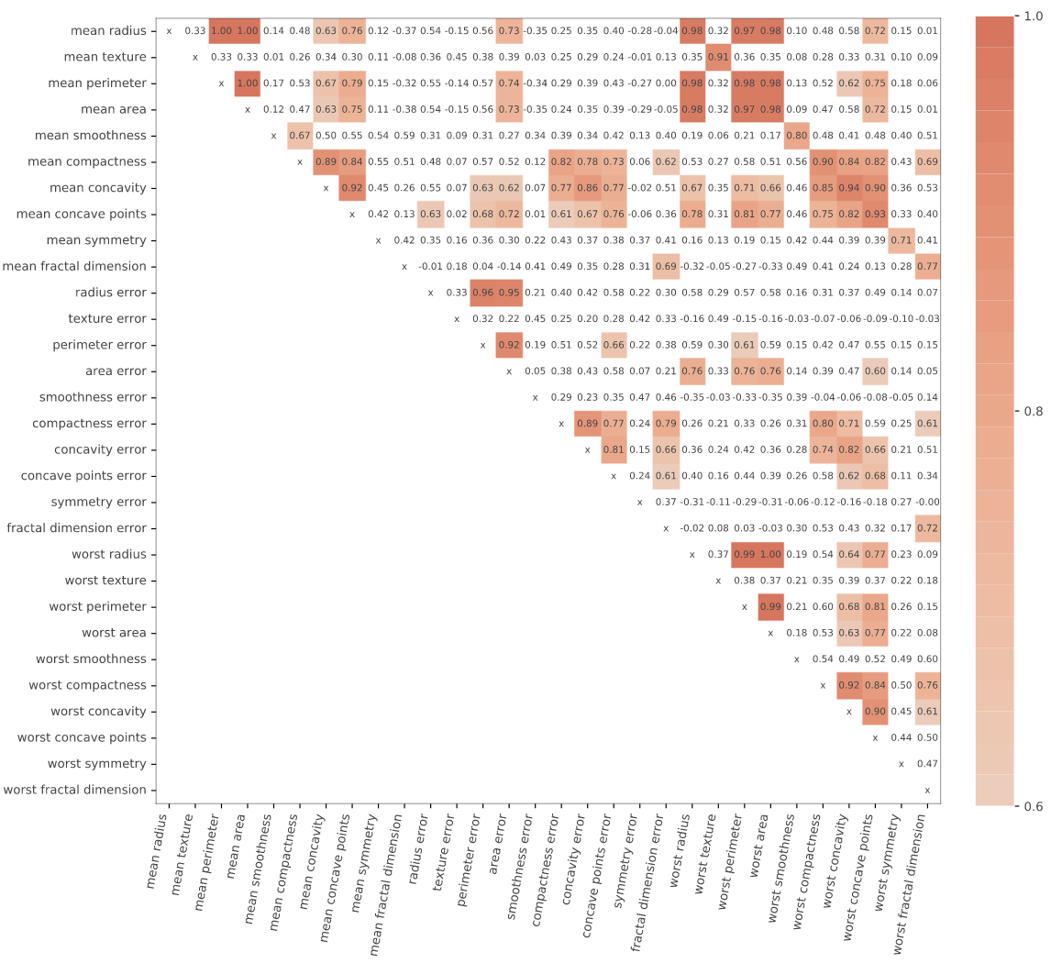
Ex: Breast cancer correlation matrix
Features are super correlated, yielding useless feature importances
Permutation
Drop column
Larger correlation image https://explained.ai/rf-importance/images/cancer_corr.svg

Slide 36
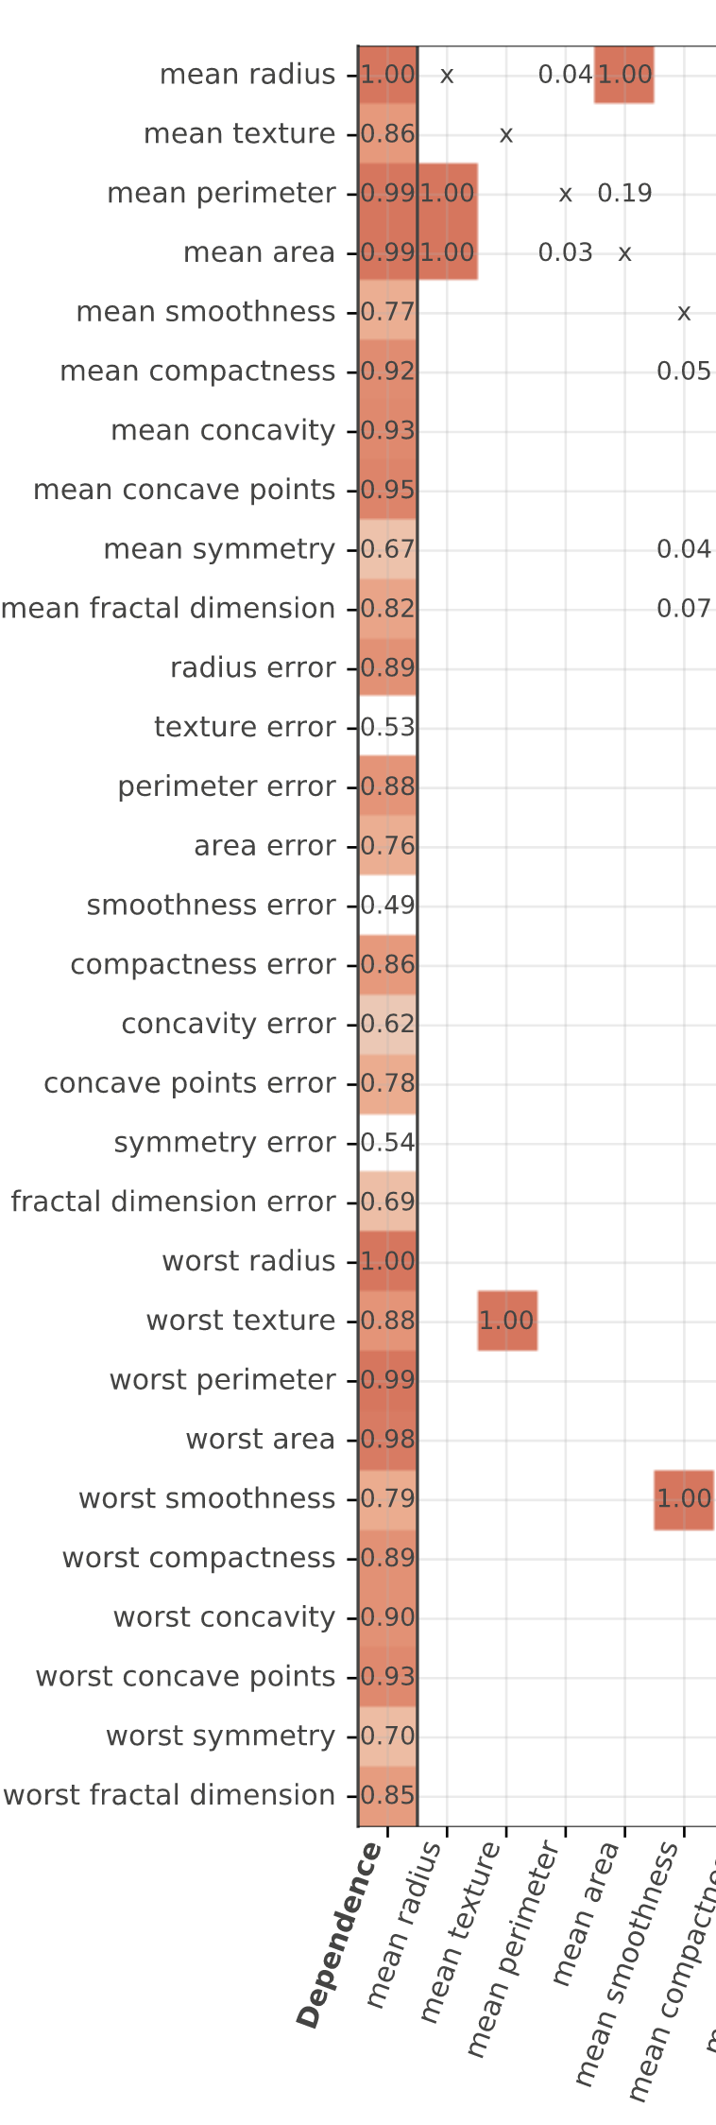
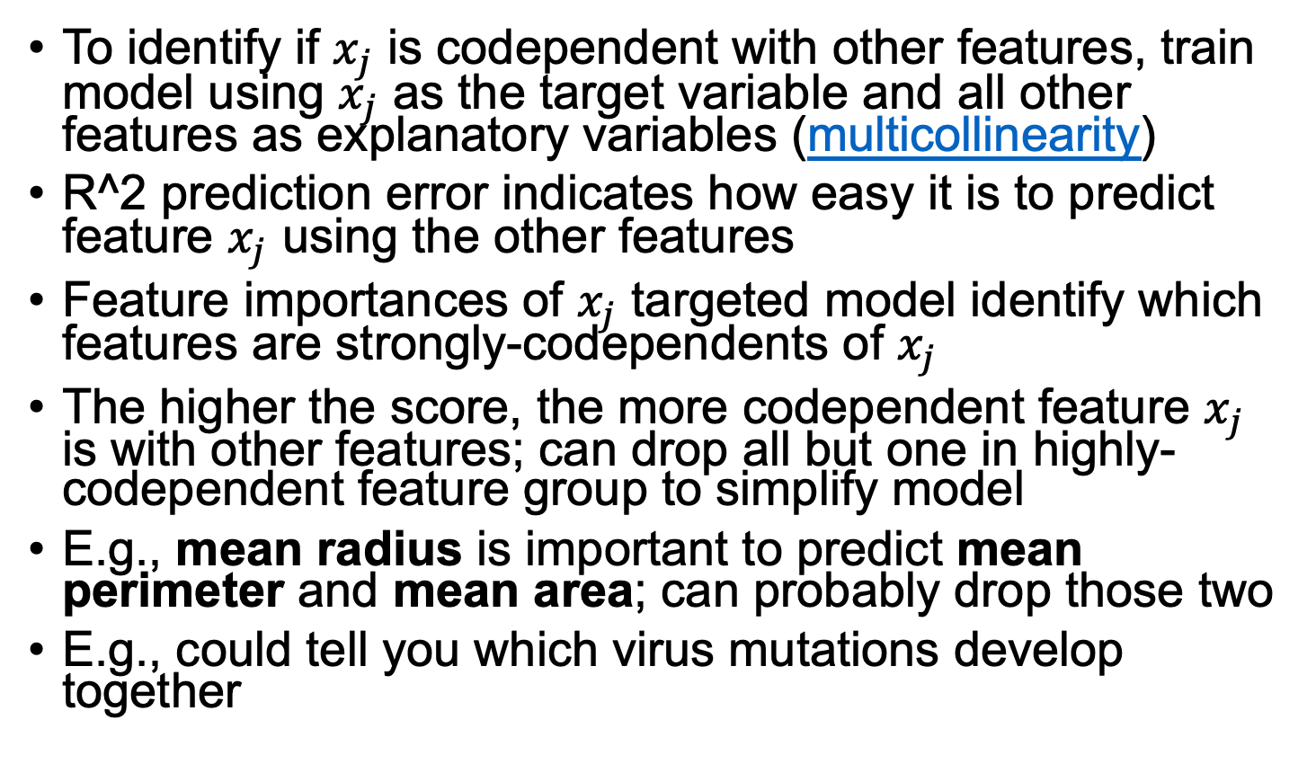
Feature codependence (stronger measure than spearman's)
To identify if $x_{j}$ is codependent with other features, train model using $x_{j}$ as the target variable and all other features as explanatory variables (multicollinearity)
R^2 prediction error indicates how easy it is to predict feature $x_{j}$ using the other features
Feature importances of $x_{j}$ targeted model identify which features are strongly-codependents of $x_{j}$
The higher the score, the more codependent feature $x_{j}$ is with other features; can drop all but one in highly-codependent feature group to simplify model
E.g., mean radius is important to predict mean perimeter and mean area; can probably drop those two
E.g., could tell you which virus mutations develop together
Bigger image https://explained.ai/rf-importance/images/cancer_dep.svg

Slide 37
Interpreting individual record results

Slide 38
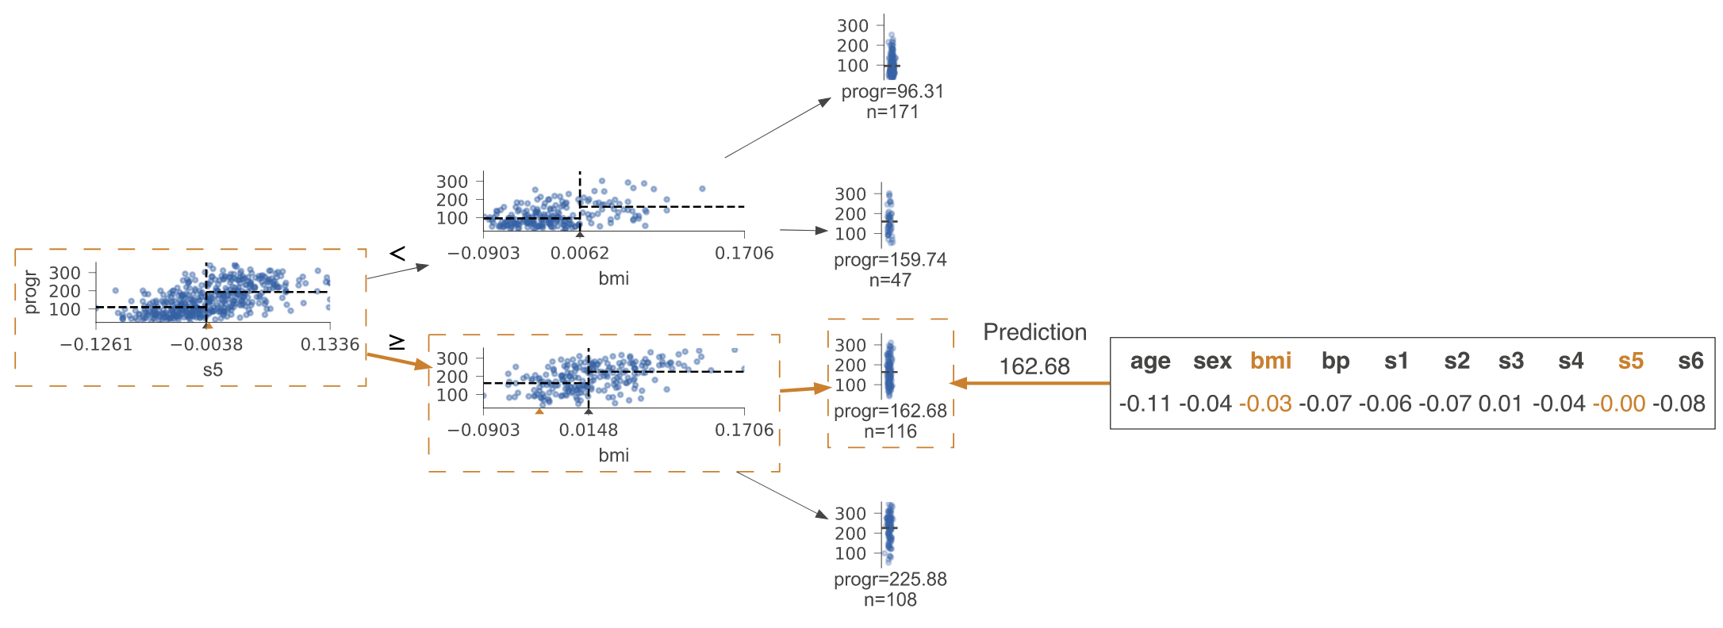
Viz how a test vector reaches leaf
Sample run ”down” regression tree

Slide 39
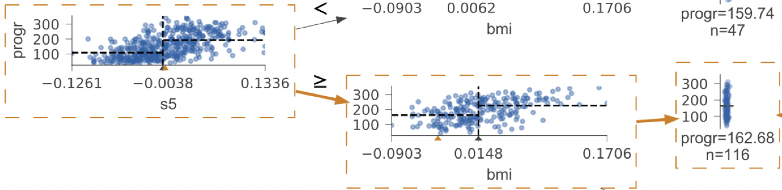
Path from root to leaf has useful info!
Which features tested?
Partitioning of feature space:
Explain prediction using vars/values:
Predict 162.68 because s5 > -0.0038 and bmi < 0.0148

Slide 40
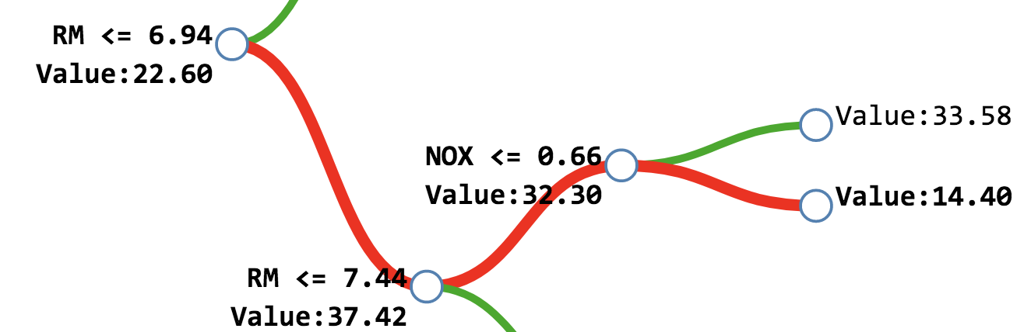
Explain regression prediction as sum of contributions along path
Using change in sample mean from each node
Start with mean(y), value of root node
Compute sample mean deltas
Prediction: 14.40 ≈ 22.60 (trainset mean) + 14.82(gain from RM) -
5.12(loss from RM) -
17.9(loss from NOX)
Image/example from http://blog.datadive.net/interpreting-random-forests/

Slide 41
Test vector feature importances (regressor example)
Revisit earlier slide; magnitude and frequency of variable contribution acts like the importance
Could also use MSE drop similar to gini drop, but drop/gain in prediction value seems more likely to be accurate
Prediction: 14.40 ≈ 22.60 (trainset mean) + 14.82(gain from RM) -
5.12(loss from RM) -
17.9(loss from NOX)
important

Slide 42
Test vector feature importances (classifier example)
First approximation: count the number of times each variable referenced along the path from root to the leaf
Improve by weighting vars by average drop in gini (mimicking ginidrop importance), but for a single record
_TOTINDA drop = .303 - .23 = 0.073
ARTHDIS2 drop = .23 - .191 = 0.039
CVDINFR4 drop = .191 - .174 = 0.017
DOCTDIAB gain = .174 - .375 = -.201
important
negatively
important
data set https://www.kaggle.com/cdc/behavioral-risk-factor-surveillance-system

Slide 43
Summary
Use permutation importance, but check drop-column too
Use only on stable, accurate model
We only get relative importances, not proportion of total variance
A 0 drop-column importance doesn’t mean useless; might also be a codependent feature
Add a noise column; can ignore any vars at or below
RF specific: can interpret single test record as drop in value or MSE/gini on path from root to leaf
Compute metric changes on validation not training set
Feature importances are clues not gospel
Useful for simplifying model
Can tell us something about the business application / market

